Slide 1
Introduction to the Intel DevCloud

Slide 2

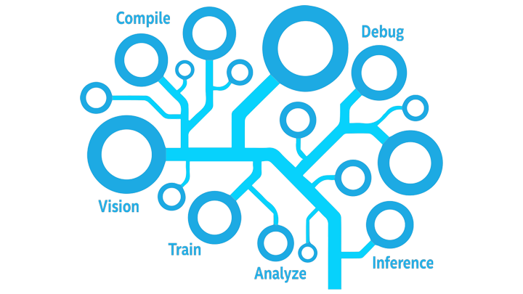
Goal
Learn the fundamentals of DevCloud.
How to access to hardware platforms hosted in Intel’s cloud environment.

Slide 3
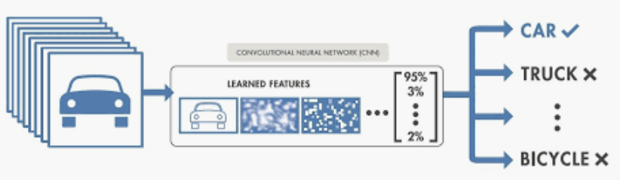
Why DevCloud
Run compute intensive and time consuming program
Machine learning model for image classification
Training phase : need more than several hours and it will be more challenge for large date sets
Compute intensive : need powerfull CPU and also GPU
FPGA also can accelerate the model

Slide 4
Using DevCloud
login a Linux-based head node of a batch farm.
Set up your code and data, compile, and submit jobs to a queue.
Once the queued job completes, your results will be in your home folder.
Benefit
Nothing stops you from running your models
Run the models within minutes through powerful CPU, GPU, or FPGA.

Slide 5


Who can use DevCloud?
Developers, data scientists, professors, students, start-ups and others can request access for full access to the latest Intel CPUs, GPUs, and FPGAs, Intel oneAPI Toolkits, and the new programming language, Data Parallel C++ (DPC++).
Access is free for 120 days with the possibility of an extension
The link of request access:
https://intelsoftwaresites.secure.force.com/devcloud/

Slide 6
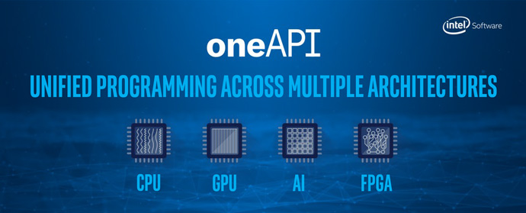

Intel Devcloud
Cluster of Intel® Xeon® Scalable Processors connected to GPUs and FGAs.
Taking advantage of multiple types of architectures is a challenge for developers
Separate tools are required for each architecture and code reuse is limited.
DevCloud provides access to precompiled software optimized for Intel® architecture.
Intel provided a unified, cross-architecture programming model called oneAPI.
Reduce programming complexity.
Minimize the barriers to adopt new innovative hardware technology.
oneAPI toolkit is available on the DevCloud
https://www.youtube.com/watch?v=sLkS25ZdzsI

Slide 7
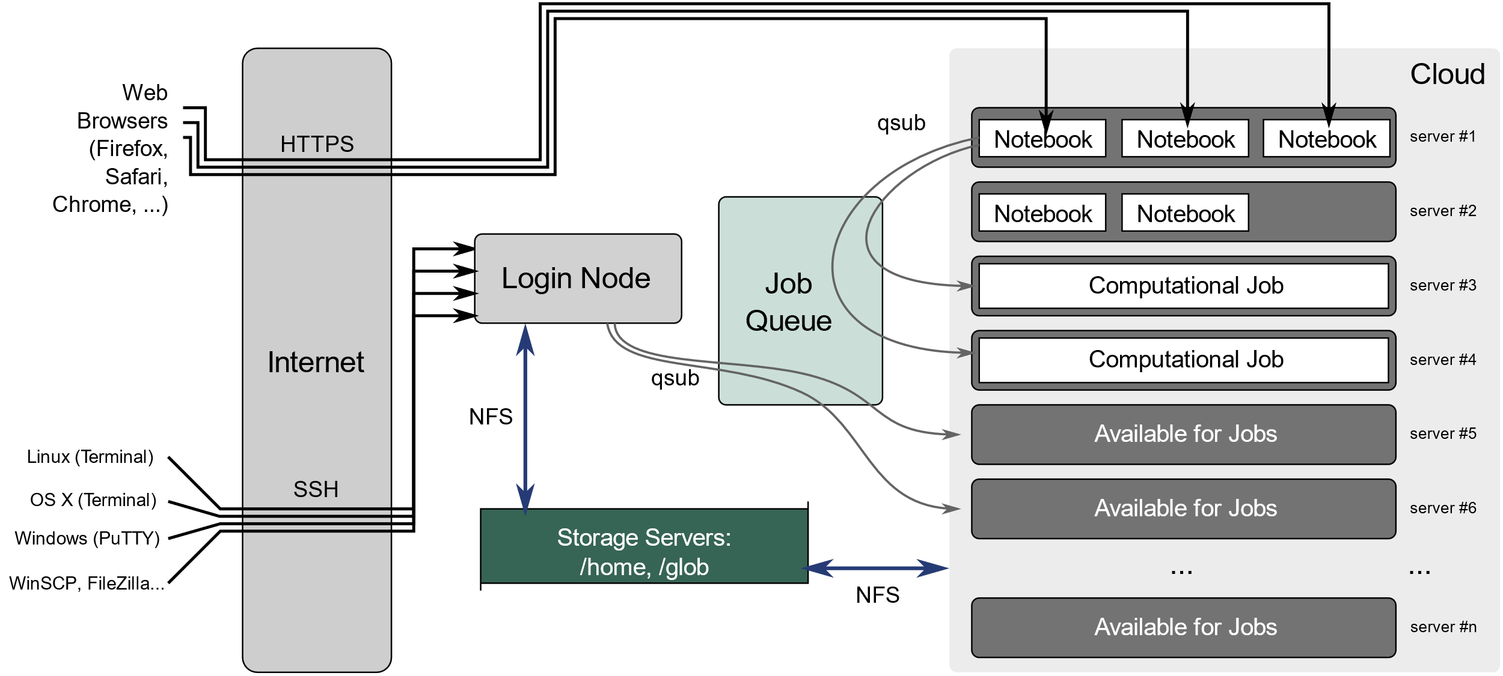
Architecture of DevCloud
The cluster consists of multiple compute servers
compute nodes
storage servers
login node

Slide 8
Access the DevCloud (I)
Run a Jupyter Notebook session directly on one of the compute nodes.
Runs on one of the compute nodes. Execute the Notebook cells => run on an Intel Xeon Scalable processor.
There may be other people connecting to your compute node => reduces the available compute power.
Reserve a full node for your job and even use multiple nodes at once by submitting scripts to the job queue.
https://devcloud.intel.com/datacenter/learn/getting-started/

Slide 9
Access the DevCloud(II)
Access the login node using an SSH client in a text-based terminal
Connected to a login node with hostname login-1.
Only for code development and compilation.
Does not have much compute power.
There are limitations on CPU time and RAM usage on the login node.
The workload will be killed if it exceeds the limit.
Edit code and compile applications.
Submit jobs to a queue for execution on compute nodes to run computational applications
https://devcloud.intel.com/datacenter/learn/getting-started/

Slide 10
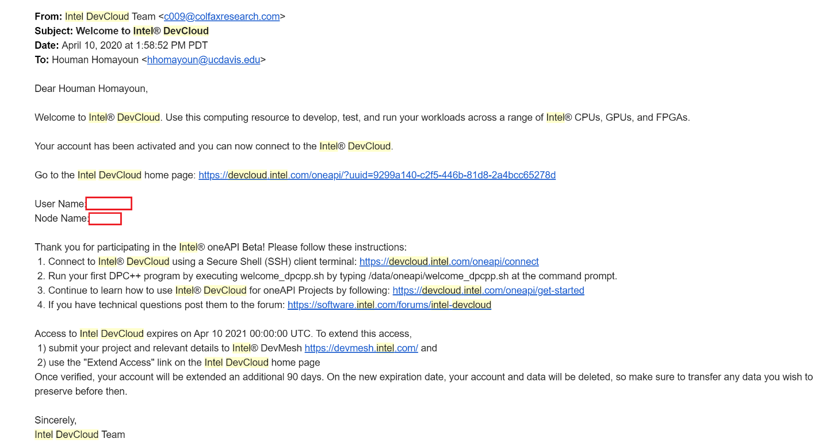
Connected to DevCloud
Signup successfully for DevCloud => receive your credentials to your registered email address.
Do not lose this email.

Slide 11
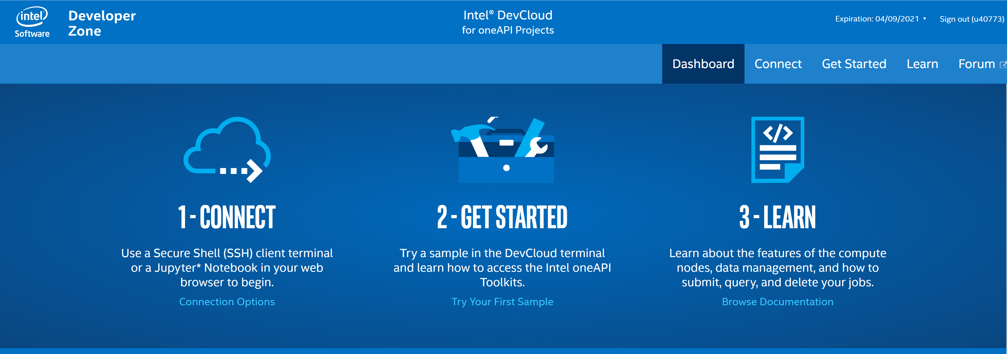
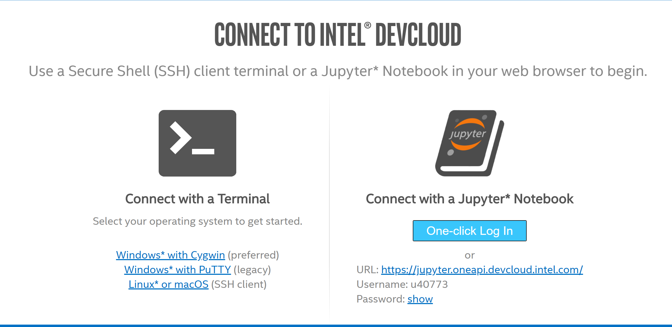
Connected to DevCloud
By clicking on the Intel DevCloud home page, you will be redirected to the following page:
By selecting connect, you have two approaches to access DevCloud.

Slide 12
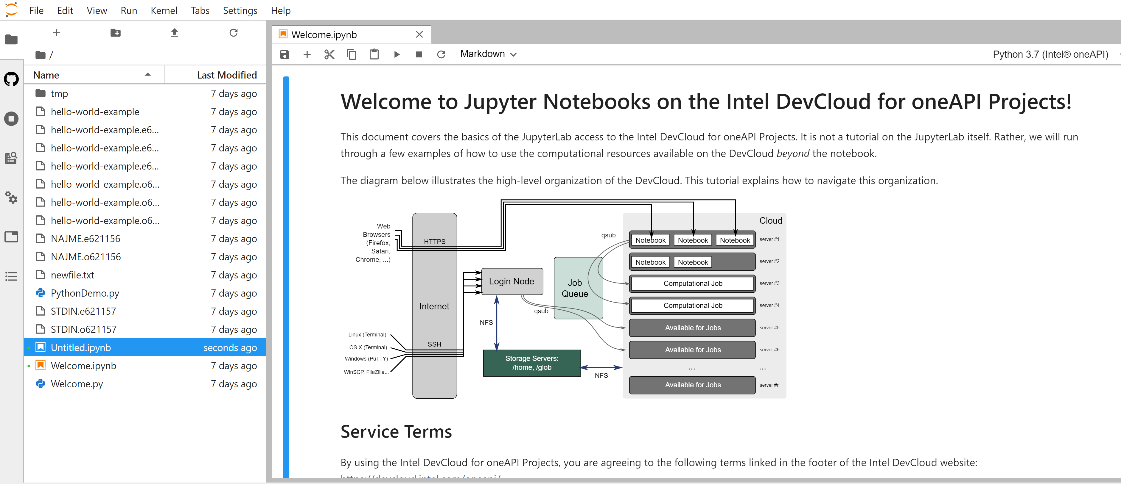
I ) Connect with Jupiter Notebook
Click on one-click login, wait for a moment and let the Jupyter Lab environment to come up. Afterwards, you can see the interface like below:
There is Welcom.ipynb in your home folder. It is very helpful tutorial to get familiar with Jupyter Notebook in DevCLoud.

Slide 13
Jupyter Notebook Basics
You can find detailed documentation on using the JupyterLab software at jupyter.org.
Nutshell ;
When you see cells like below (the line that begins with !echo "Running..."), this is code that you can run.
If you mouse-click on the cell, you will be able to edit the code.
While you are in the cell, press Ctrl+Enter to run the code in the cell.
In the top-right corner of the page, the indicator will change to . This means that the kernel is busy.
If the code begins with "!", it will run in the Bash shell. Otherwise, it is treated as Python code.

Slide 14
Job
Anything that we want to run on DevCloud is a job
training a neural network, compiling C++ code, and running an application.
Basic Job Submission:
The job queue is the only method for accessing the full capacity of the computing resources available on the DevCloud.
To submit a job, we need to create Job Script in Bash first.

Slide 15

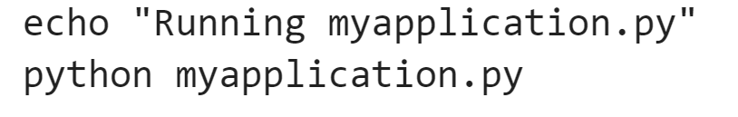
Creating a Job Script
The first line of script should contain the following code:
changes the working directory to the directory where the script is located.
The rest of script can be a regular Bash script.
Have an empty line at the end of the file; otherwise the last command will not run.
only Bash job scripts are supported.
If you need to run a Python application
add the corresponding Python launch line to your Bash job script. For example:

Slide 16
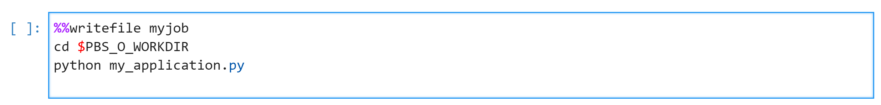
Submitting a Job to the Queue:
Submit your job script : !qsub <name of your job script>
Submitting a job can be done through a job script file.
For Python application, ‘my_application.py’. Suppose that the application
Imports some Python modules,
Loads a dataset,
Sets up a neural network
Trains it, and
Writes the resultant model weights into a file.
Submit Python application as a job to the queue.
In the same folder, use your favorite text editor and create a file “myjob” script.
Or you can use %%writefile <name of your file> to create a new file in Jupyter cell. Then add the following two lines:
Creates a file with name in front of it and then writes all the lines after the command to the file.
Ensures that the script runs in the same directory as where you have submitted it
Runs the Python application
! qsub myjob
Now submit this job :
Output of the job : [numbers].cXXX"

Slide 17
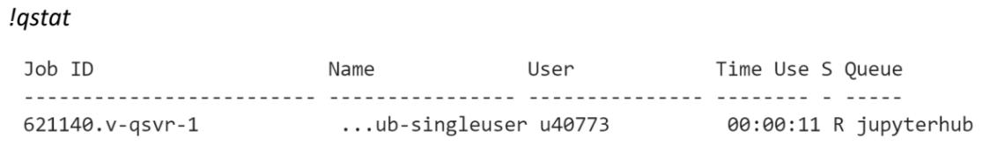
Checking the Queue Status
When the job has been placed in the queue, you can find the current status of the job by running the following command in a cell:
R: Runnig
E: Error or a transition to a normal job
Q: Queued

Slide 18

Getting the Result
When job is completed
Output: [Job Name].o[Job ID]. myjob.o12345
Error: [Job Name].e[Job ID]. myjob.e12345
[Job Name]: the script name, or a custom name.
[Job ID]: the number that got from the output of the qsub command
%cat command: see the content of a file

Slide 19

Qsub Parameters
!qsub <file>command can take a variety of parameters that we can set.
Above command requests a wall clock time limit of 24 hours and passes a command line argument equal to "13.2" to the job

